Slide 1
WELCOME
WEEK 10

Slide 2
CORRELATION AND CORRELATION COEFFICIENTS
What are they?
When to use them?
And How to use them?

Slide 3
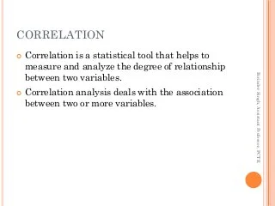

Slide 4
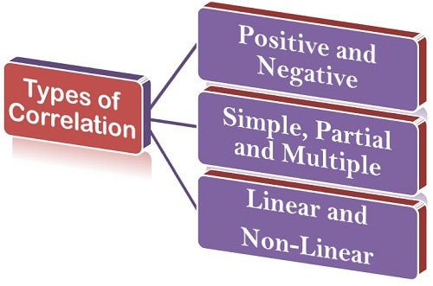

Slide 5
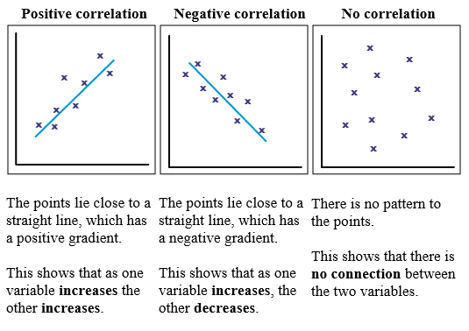
TYPES OF CORRELATION

Slide 6
OUR FOCUS WOULD BE ON PEARSON, KENDALL’s TAU AND SPEARMAN COEFFICIENTS

Slide 7
Pearson’s Correlation
The Pearson correlation coefficient between two variables will always return a value between -1 and 1. The further the value is from 0 the stronger the relationship.
Both variables should be continuous variables, sometimes referred to as interval or ratio variables (all ratio variables are interval variables, but only certain cases of interval variables are ratio variables).
The two variables you are checking the correlation between should both be normally distributed, think bell curve when you plot them.
Outliers need to be handled ahead of time as they can greatly affect the correlation coefficient that is returned.

Slide 8
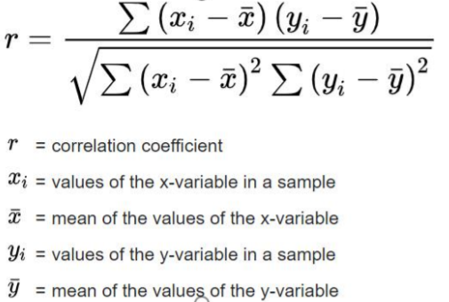

Slide 9
Kendall’s Rank Correlation
While Pearson’s measures a linear relationship between two variables, Kendall’s and Spearman’s, which is covered later, both measure the monotonic relationship.
While linear relationships mean two variables move together at a constant rate, think straight line, monotonic relationships measure how likely it is for two variables to move in the same direction, but not necessarily at a constant rate.
The upward exponential curve formed by y=x^2 (assuming positive values for x) would have a strictly positive monotonicity because as x increases y also always increases, but the curved line is not linear because the rate y changes vary at different values of x.
Like Pearson’s correlation, Kendall’s will return a value between -1 and 1 with -1 being a strictly negative monotonic relationship (the variables are inversely related), 1 being a strictly positive monotonic relationship, and 0 representing no relationship.

Slide 10
Kendall’s Rank Correlation
5. Kendall’s is often used when data doesn’t meet one of the requirements of Pearson’s correlation. Kendall’s is non-parametric meaning that it does not require the two variables to fall into a bell curve. Kendall’s also does not require continuous data. Because it is based on the ranked values of each variable it will work with continuous data, but it can also be used with ordinal data..

Slide 11
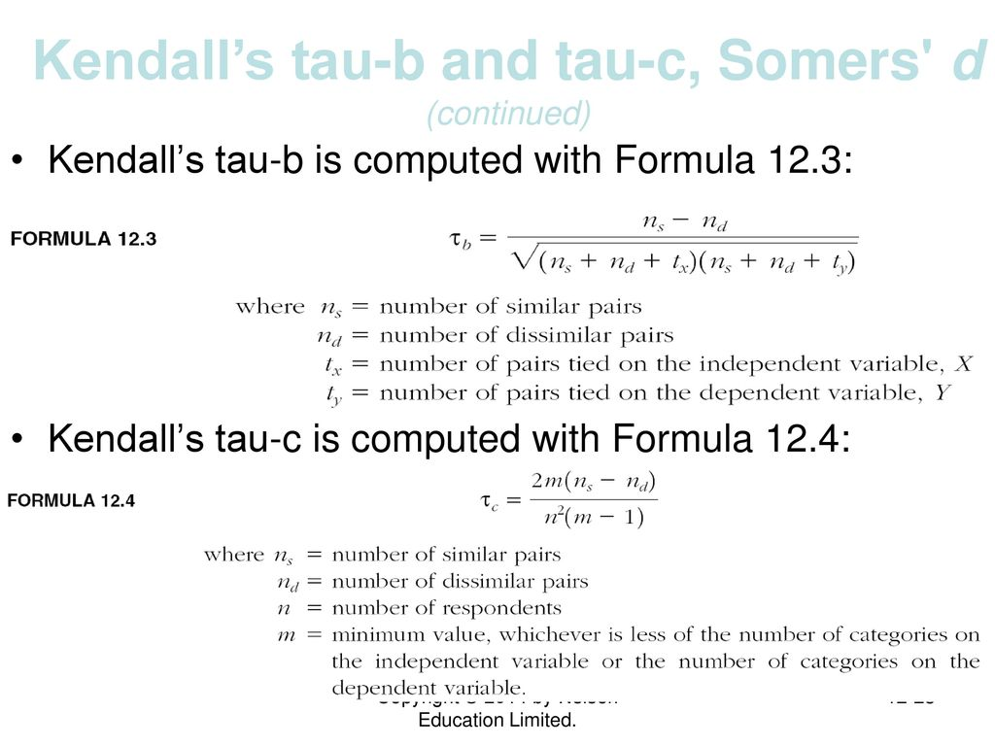

Slide 12
Non-Parametric tests
Nonparametric statistics is the branch of statistics that is not based solely on parametrized families of probability distributions. Nonparametric statistics is based on either being distribution-free or having a specified distribution but with the distribution's parameters unspecified.

Slide 13
Spearman’s Rank Correlation
Spearman’s is incredibly similar to Kendall’s. It is a non-parametric test that measures a monotonic relationship using ranked data.
While it can often be used interchangeably with Kendall’s, Kendall’s is more robust and generally the preferred method of the two.
An advantage of Spearman’s is that it is easier to calculate, but in a data science context, it is unlikely you’ll be working anything out by hand and both methods are computationally light relative to many other tasks you’ll be performing.

Slide 14
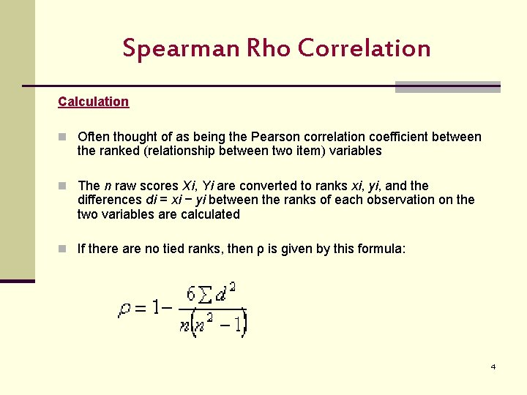

Slide 15
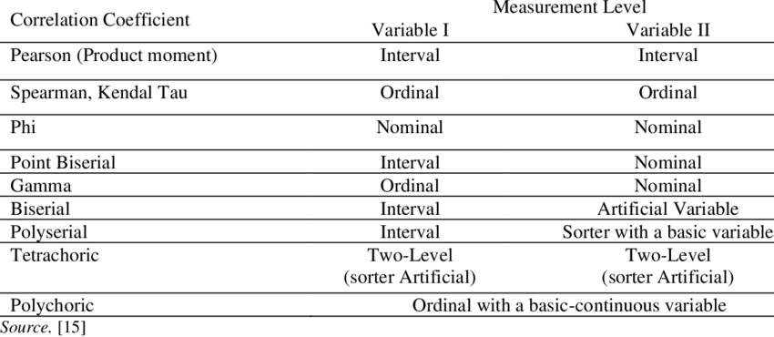
Correlation coefficients and their MLs

Slide 16
ENCODINGS: label and one-hot encodings
What are they?
When to use them?
And How to use them?

Slide 17
Label Encoding refers to converting the labels into a numeric form so as to convert them into the machine-readable form.

Slide 18
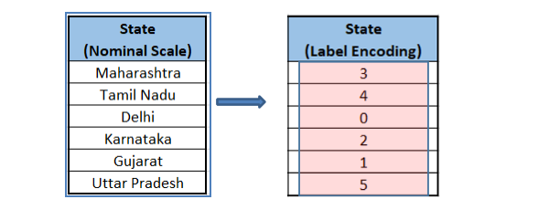

Slide 19
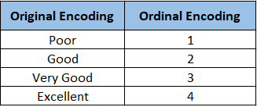

Slide 20
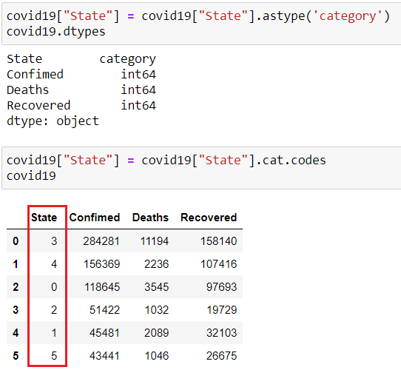

Slide 21
A one hot encoding is a representation of categorical variables as binary vectors. This first requires that the categorical values be mapped to integer values. Then, each integer value is represented as a binary vector that is all zero values except the index of the integer, which is marked with a 1

Slide 22
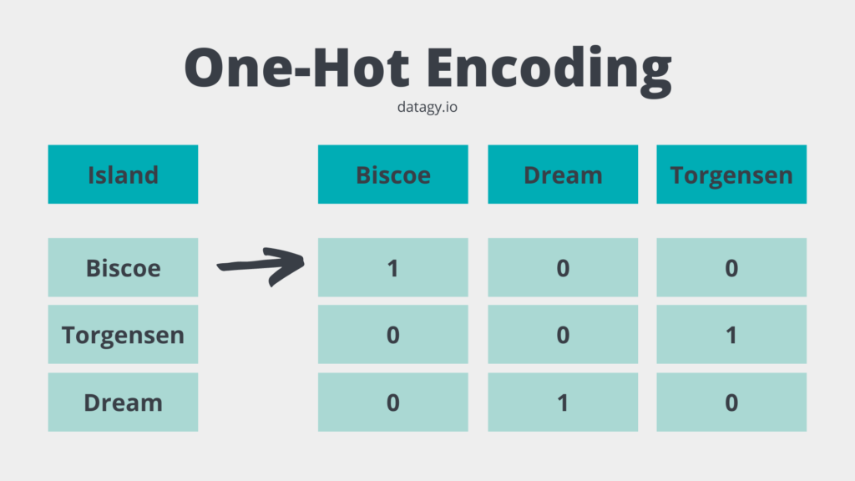

Slide 23
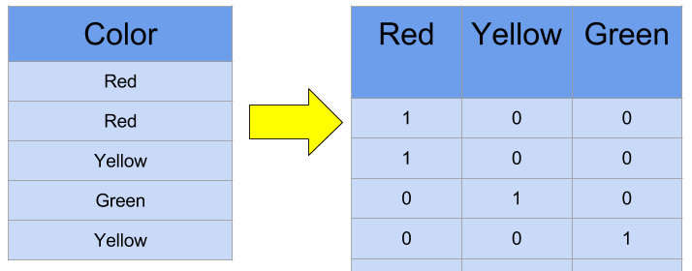

Slide 24
SCALERS AND TRANSFORMATIONS
Practical applications of MinMax, Robust and standard scalers

